Slide 1
The Outsiders Adapted Book
By: S. E. Hinton
Adapted by: Beth Frisby & Christina Quattro
Haralson County School System
Fall 2013

Slide 2
The Outsiders is a twelve chapter book written by S. E. Hinton. The setting of the book is in Tulsa, Oklahoma.
Setting:
Tulsa, Oklahoma
1965

Slide 3
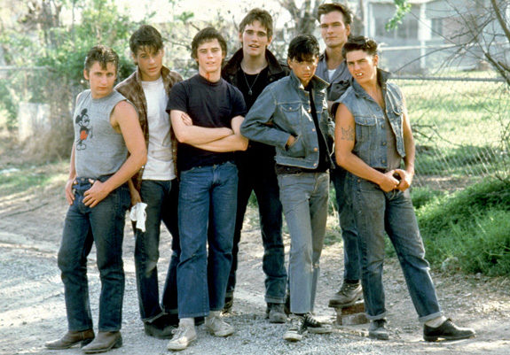
The Greasers

Slide 4
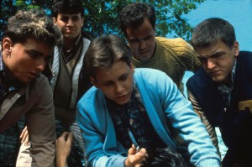
The Socs

Slide 5
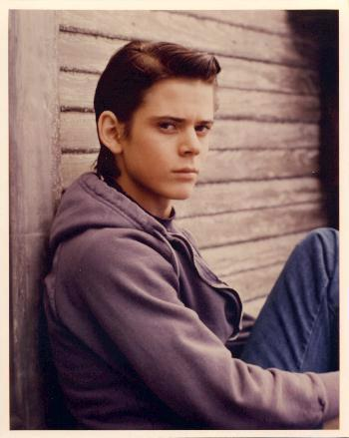
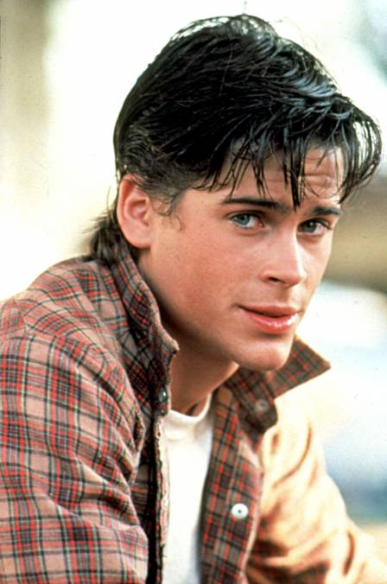
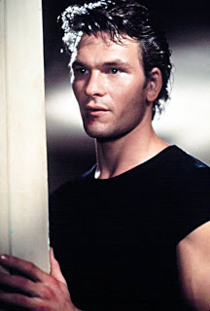
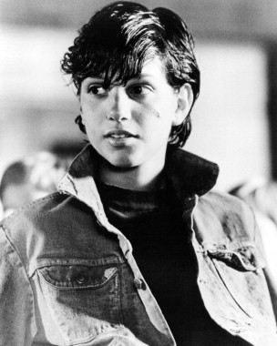
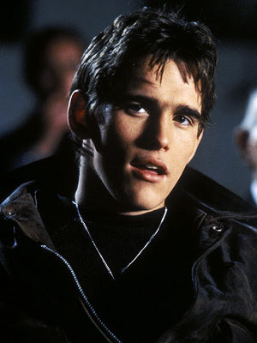
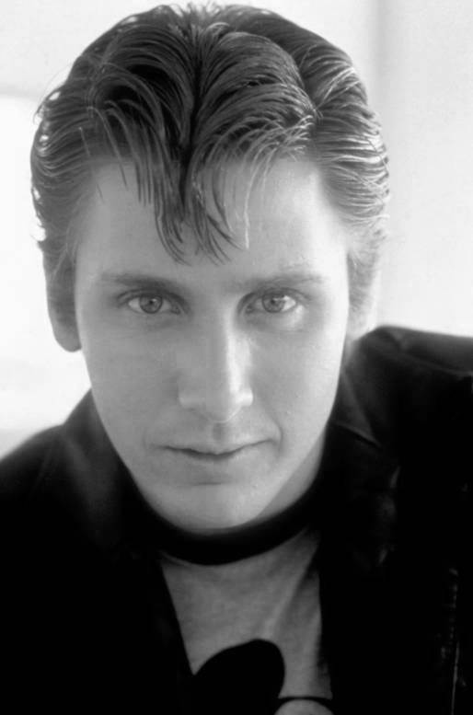
The Greasers Characters
Ponyboy (The Narrator) Sodapop Darry
Johnny Dally Two Bit

Slide 6
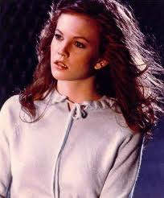
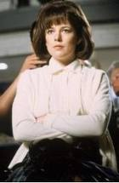
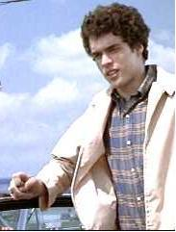
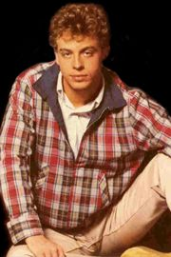
The Socs Characters
Cherry Marcia Randy Bob

Slide 7
Let’s Read!

Slide 8
Chapter 1

Slide 9
“When I stepped out into the bright sunlight from the darkness of the movie house, I had only two things on my mind: Paul Newman and a ride home.”

Slide 10
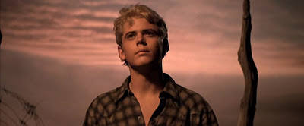
Ponyboy walks home after seeing a Paul Newman movie. He likes to see movies alone, but wishes he had a friend to walk home with. Walking alone is not safe for Greasers, the East Side gang he belongs to. The Socs, the rich West Side crowd, like to cause trouble when they see Greasers alone.

Slide 11
Ponyboy thinks about the differences between the Greasers and the Socs. The Greasers are poorer. They have long hair and put grease in it. They dress tough, steal, and get into gang fights. They carry knives for protection.

Slide 12
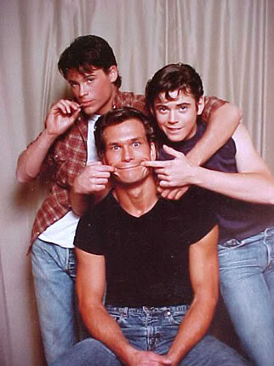
Ponyboy does not misbehave
because his big brother Darry
would be angry if he got in
trouble.
Ponyboy’s parents died in
a car crash, so the three
brothers live by themselves. Darry acts like the father of the family. Ponyboy’s other brother is named Sodapop.

Slide 13
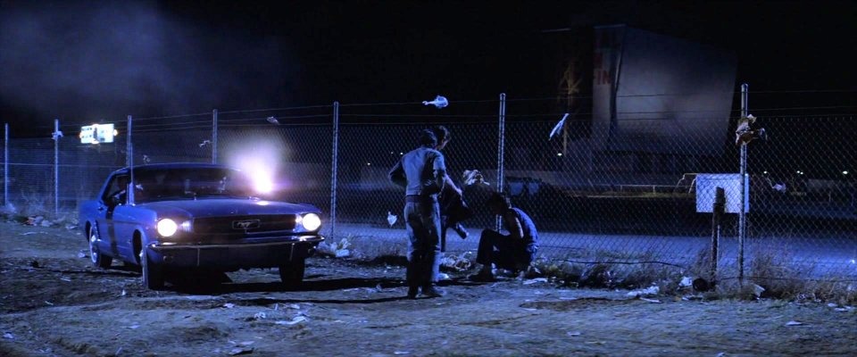
As Ponyboy walks home, he sees a red car following him. He starts to walk faster. The car stops and five Socs get out. They beat up Ponyboy. A group of Greasers show up and chase the Socs away.

Slide 14
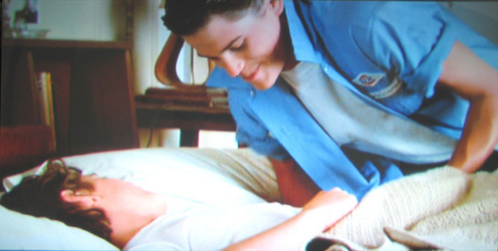
At home, Darry scolds Ponyboy for walking home alone, but Sodapop tells him to stop nagging.
Because Ponyboy is still upset from the fight, he climbs into bed with Sodapop.

Slide 15
Chapter 2

Slide 16
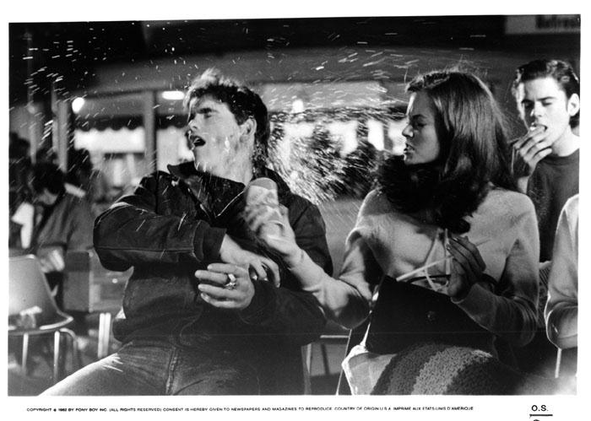
The next night, Ponyboy, Johnny, and Dally go see a movie at the drive-in movie theater. They sit behind two Soc girls, and Dally talks rudely to them. The girl with red hair, Cherry, turns around and tells him to stop, but Dally keeps going.
Dally gives a coke to
Cherry, but she
Throws it in his face.
When Dally does not
stop, Johnny tells him
to stop bothering the
girls.

Slide 17
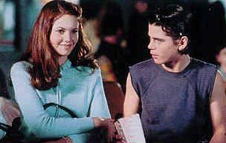
Dally leaves and Cherry and her friend Marcia invite Ponyboy and Johnny to watch the movie with them.
Cherry and Ponyboy go get popcorn, and Ponyboy tells her about the time the Socs beat up Johnny. Cherry looks sad and tells him not all Socs are violent. Ponyboy doesn’t believe her.

Slide 18
Chapter 3

Slide 19
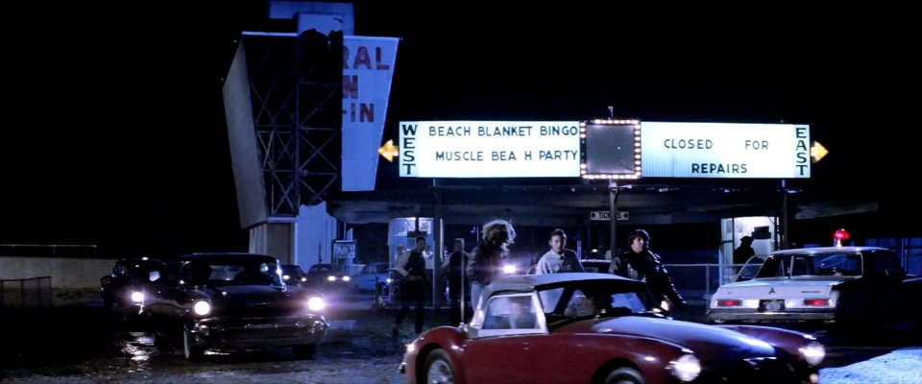
Ponyboy, Two-Bit, and Johnny offer to give Cherry and Marcia a ride home. Ponyboy thinks it is easy to talk to Cherry. Cherry asks him about his older brother, Darry, and Ponyboy says Darry does not like him.

Slide 20
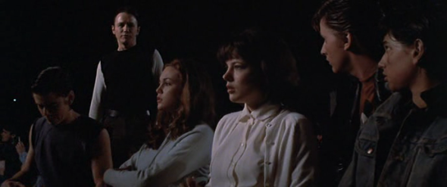
Ponyboy and Cherry see they have a lot in common- they both like to read and watch sunsets. They talk about the differences between the Socs and the Greasers. The biggest difference is that the Socs are too cool to talk about their emotions, while the Greasers feel emotions too strongly. Ponyboy realizes that even though they come from different classes, he and Cherry watch the same sunset.

Slide 21
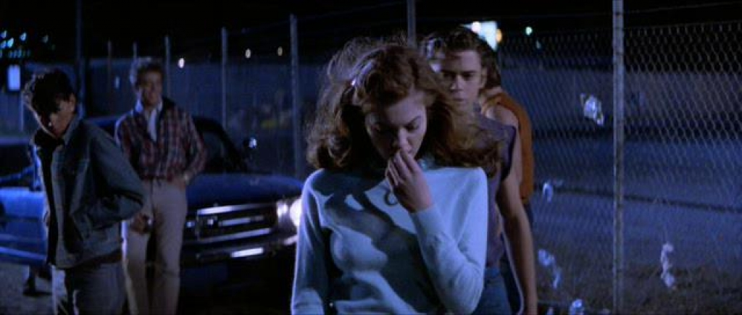
A blue car stops beside the group. The car belongs to Bob and Randy, Cherry and Marcia’s Soc boyfriends. The Greasers and Socs almost get into a fight, but the girls agree to leave with their boyfriends.

Slide 22
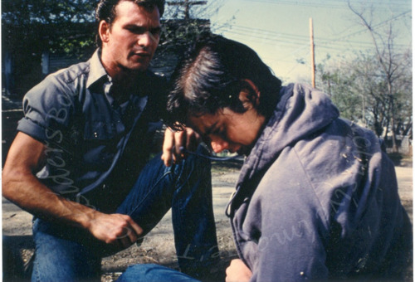
Ponyboy gets home and Darry is angry with him for being out so late. Darry slaps Ponyboy. Ponyboy leaves the house angry. It is the middle of the night. Ponyboy goes to find Johnny and tells him they are going to run away.
Johnny agrees.

Slide 23
Chapter 4

Slide 24
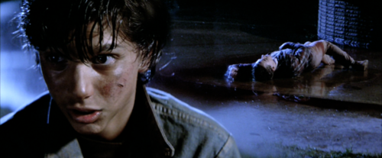
As they are leaving, the blue car from earlier stops and a group of Socs get out. The Socs came to get even with them for talking to their girlfriends. A Soc grabs Ponyboy and holds his head under water until he blacks out. He wakes up on the ground next to Johnny. Bob is next to them, dead. Johnny says he killed him.

Slide 25
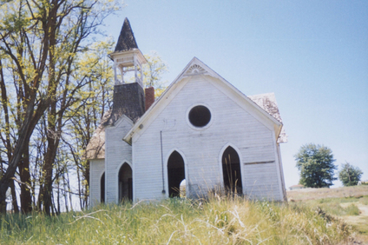
The boys find Dally, thinking he can help. Dally gives the boys fifty dollars, a change of clothes, and a gun. He tells them to take a train to Windrixville and hide in an abandoned church. After they arrive, they go straight to sleep.

Slide 26
Chapter 5

Slide 27
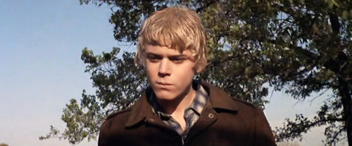
The next morning, Johnny goes to the store to buy bologna, cigarettes, and the book Gone with the Wind. Johnny says they need to cut their hair to disguise themselves, and he bleaches Ponyboy’s hair.

Slide 28
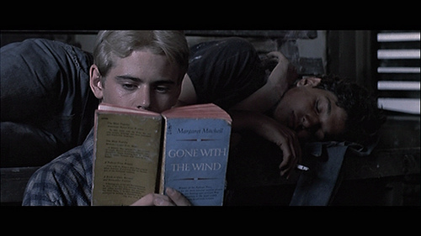
During the next week, the boys hide out at the church, read Gone with the Wind, smoke, and eat sandwiches.

Slide 29
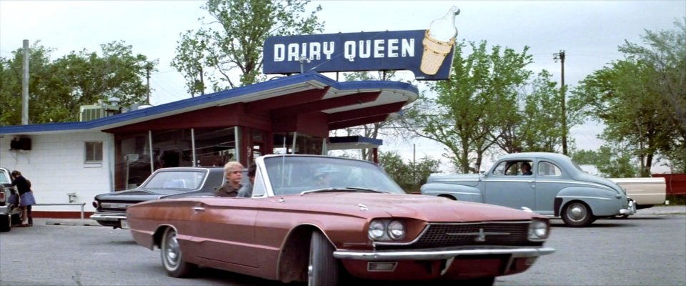
After five days, Dally shows up. He takes the boys to Dairy Queen. He says the police asked him about Bob’s murder and tells them in a few days the Greasers and the Socs will meet for a big fight.

Slide 30
Chapter 6

Slide 31
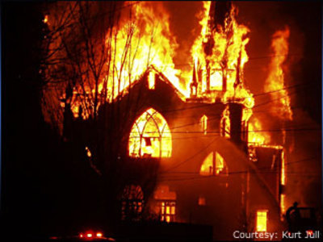
Johnny says he wants to go home and confess his crime because it is unfair to Ponyboy. Dally tries to change his mind, but Johnny does not give up. Dally begins to drive the boys home.
As they drive past
the church, they
see that it is on
fire. The boys
jump out of the
car to look at the
church.

Slide 32
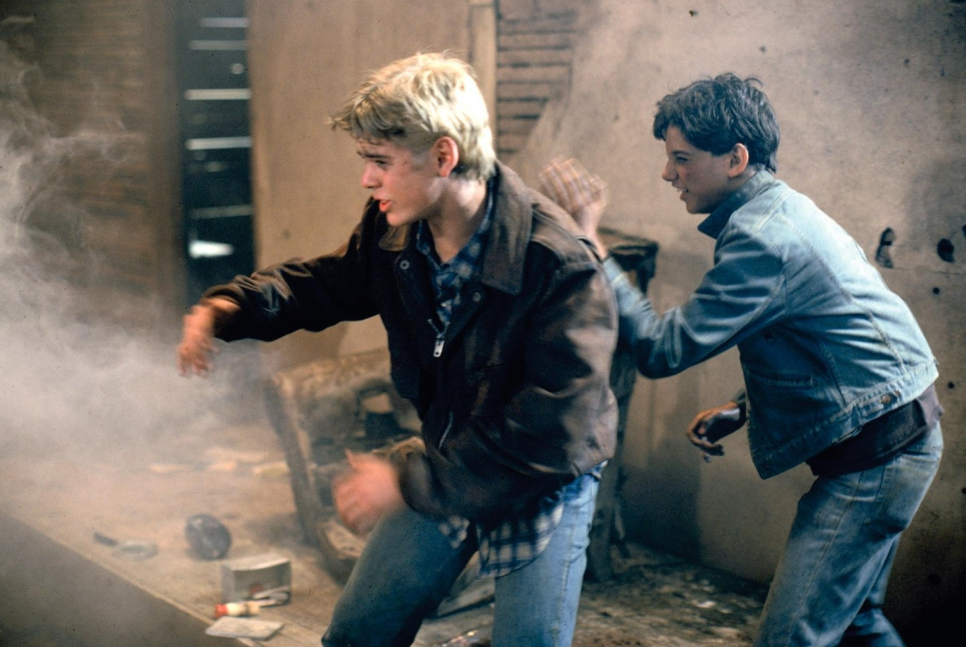
They find school children on a picnic and an adult is crying that some children are missing. Ponyboy hears screaming from inside, so he and Johnny go into the burning church. They find the children and lift them out a window. As they lift the last child out, the roof crumbles. Johnny pushes Ponyboy out the window, and Ponyboy hears Johnny scream. Ponyboy starts to go back for Johnny, but something hits his back and knocks him out.

Slide 33
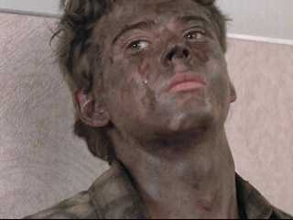
When Ponyboy wakes up, he is in an ambulance with one of the adult school teachers. The teacher tells Ponyboy that his back caught on fire. He also says that Dally was burned but would be fine and Johnny was in bad shape.

Slide 34
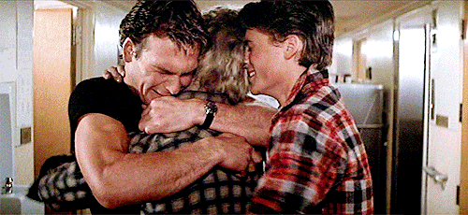
Darry and Sodapop come to see Ponyboy in the hospital. Sodapop hugs Ponyboy and Darry cries. The anger Ponyboy felt at Darry went away. Ponyboy learned that Darry does care about him; he is strict because he loves Ponyboy and wants him to be safe.

Slide 35
Chapter 7

Slide 36
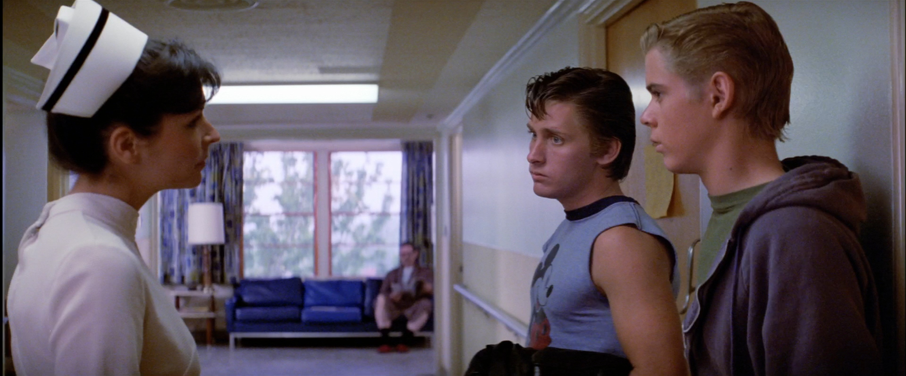
The police interview Ponyboy, Sodapop, and Darry in the hospital.
The doctors say that Dally will be fine. They say that Johnny's back was broken when the roof caved in. If Johnny lives, he will be hurt for the rest of his life.

Slide 37
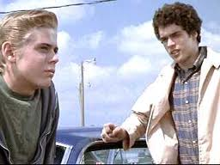
Two-Bit and Ponyboy get cokes at the Tasty Freeze. A blue car pulls up to the restaurant, and they see the group of Socs that jumped Ponyboy in the park.
Randy walks over and says he wants to talk. He is not going to fight at the big fight because he is sick from Bob’s death. Randy says that Bob was his best friend. Ponyboy realizes that Socs can be human too.

Slide 38
Chapter 8

Slide 39
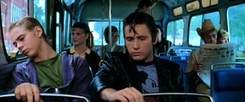
After the talk with Randy, Two-Bit and Ponyboy go see Johnny and Dally in the hospital. They bring Johnny another copy of Gone with the Wind, since his copy burned in the fire.
On the way home, they see Cherry. She says the Socs agree to fight with no weapons. He asks her if she can see the sunset on the West Side, and when she says she can, he tells her to remember he can see it on the East Side too.

Slide 40
Chapter 9

Slide 41
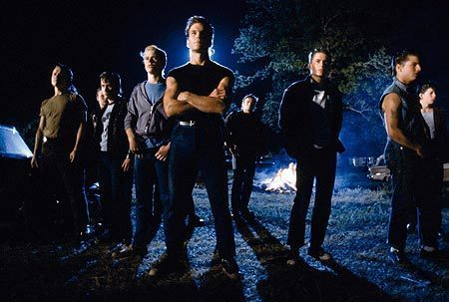
Before the big fight, the boys took a bath and made themselves look tough. Twenty-two Socs show up to fight the twenty Greasers. Darry starts the fight against a Soc member and the fight breaks out.
After a long fight,
the Greasers win.

Slide 42
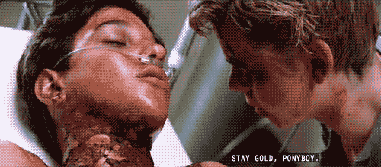
When the fight ends, Dally and Ponyboy go to the hospital to see Johnny. They find Johnny dying. Johnny tells them that fighting is useless and tells Ponyboy to “stay gold,” then he dies. Dally is filled with sadness and runs out of the room.

Slide 43
Chapter 10

Slide 44
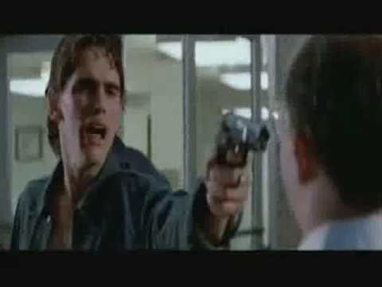
Ponyboy leaves the hospital alone. His head is bleeding and he is confused. At home, he tells a group of Greasers that Johnny died. Right then, Dally calls and says he robbed a grocery store and is running from the police.
The Greasers go out and see the police chasing Dally. Dally starts to pull out his gun and the police shoot him down. Dally falls to the ground, dead. Feeling dizzy and overwhelmed, Ponyboy passes out.

Slide 45
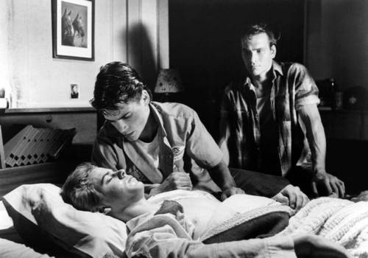
When Ponyboy wakes up, Darry is at his side. Ponyboy learns he got a concussion during the big fight. He was kicked in the head and had been in bed for three days.

Slide 46
Chapter 11

Slide 47
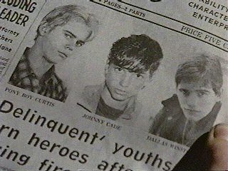
Ponyboy has to stay in bed for a week after he wakes up from his concussion.
The hearing is scheduled soon after.

Slide 48
Chapter 12

Slide 49
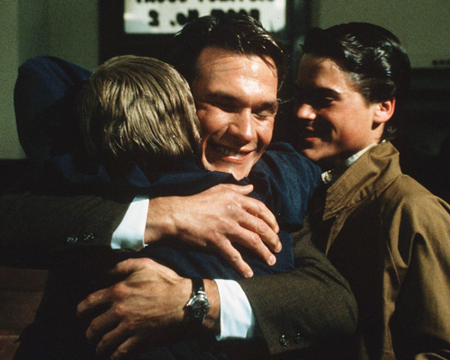
Ponyboy doesn’t speak a lot at the hearing. Cherry testifies for Ponyboy. The Judge asks Ponyboy about his home life and then clears him of all trouble.
After the hearing, Ponyboy feels sad. His grades drop and he loses his appetite. Ponyboy’s language arts teacher, Mr. Syme, says that Ponyboy is failing and can raise his grade by writing a paragraph.

Slide 50
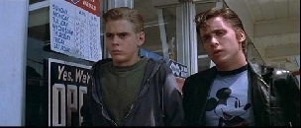
The next day at lunch, Ponyboy goes to the grocery store with Two-Bit. When a group of Socs approach them, Ponyboy threatens them with a broken bottle. Two-Bit warns Ponyboy to not grow hard like Dally.

Slide 51
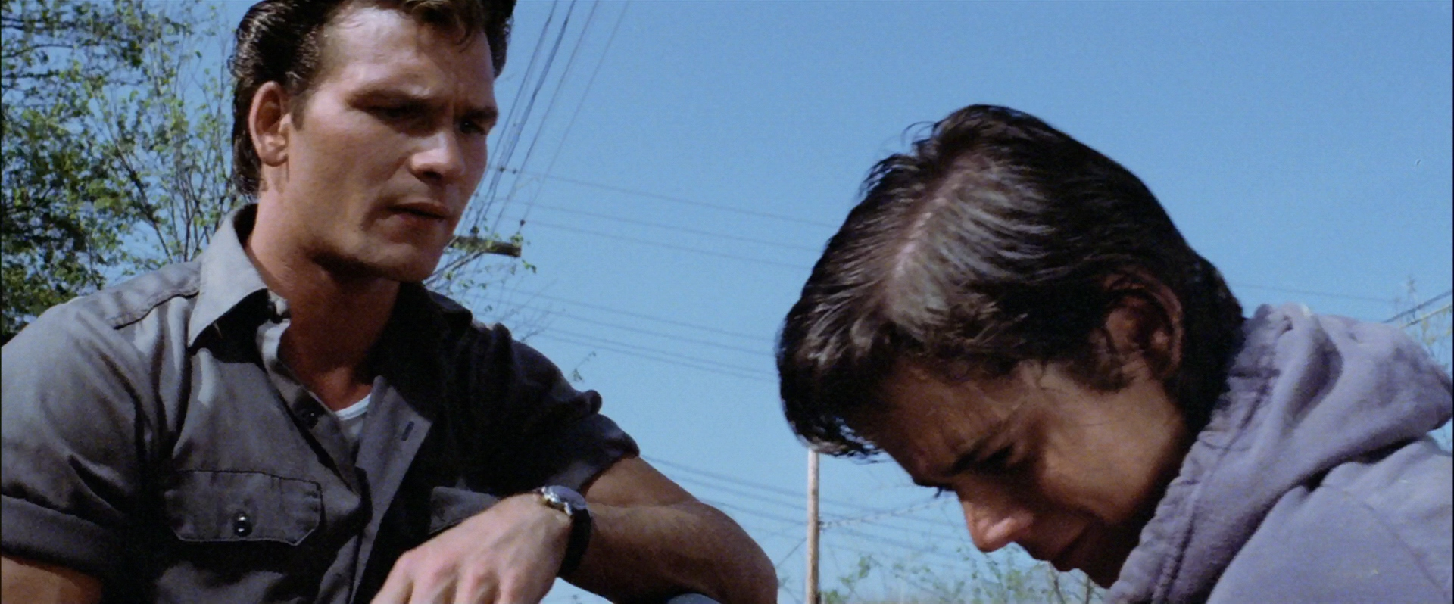
That night as Ponyboy and Darry fight about Ponyboy’s grades, Sodapop runs out of the house. They are worried and go to find him. He cries that their fighting is upsetting and asks them to stop. They promise to try.

Slide 52
The boys return home. Ponyboy reads Johnny's copy of Gone with the Wind. He finds a note from Johnny telling him to “stay gold.” Ponyboy realizes that he wants to tell the story of his friends for his paragraph so that other people will not show anger at the world and ignore the beauty in it.

Slide 53
He starts his English paragraph with “When I stepped out into the bright sunlight from the darkness of the movie house, I had only two things on my mind: Paul Newman and a ride home.”

Slide 54
The End

